Slide 1



Sales_Analytics
View in Power BI
Last data refresh:
8/29/2025 10:38:21 AM UTC
Downloaded at:
8/29/2025 10:43:45 AM UTC

Slide 2
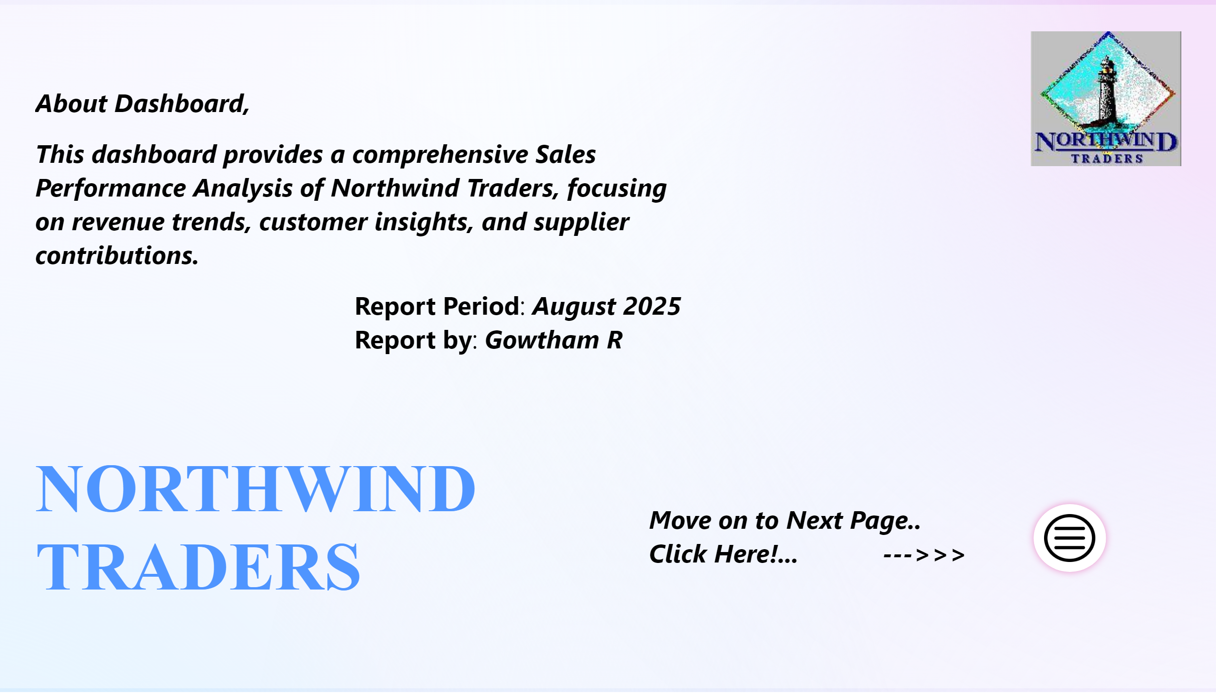
Home
Notes:
textbox
No alt text provided
actionButton
No alt text provided
textbox
No alt text provided
textbox
No alt text provided
image
No alt text provided

Slide 3
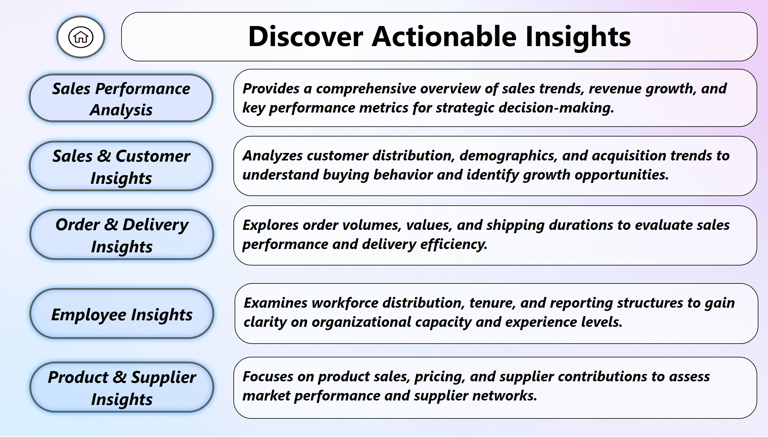
Index
Notes:
textbox
No alt text provided
textbox
No alt text provided
textbox
No alt text provided
textbox
No alt text provided
textbox
No alt text provided
actionButton
No alt text provided
actionButton
No alt text provided
actionButton
No alt text provided
actionButton
No alt text provided
textbox
No alt text provided
actionButton
No alt text provided
actionButton
No alt text provided

Slide 4
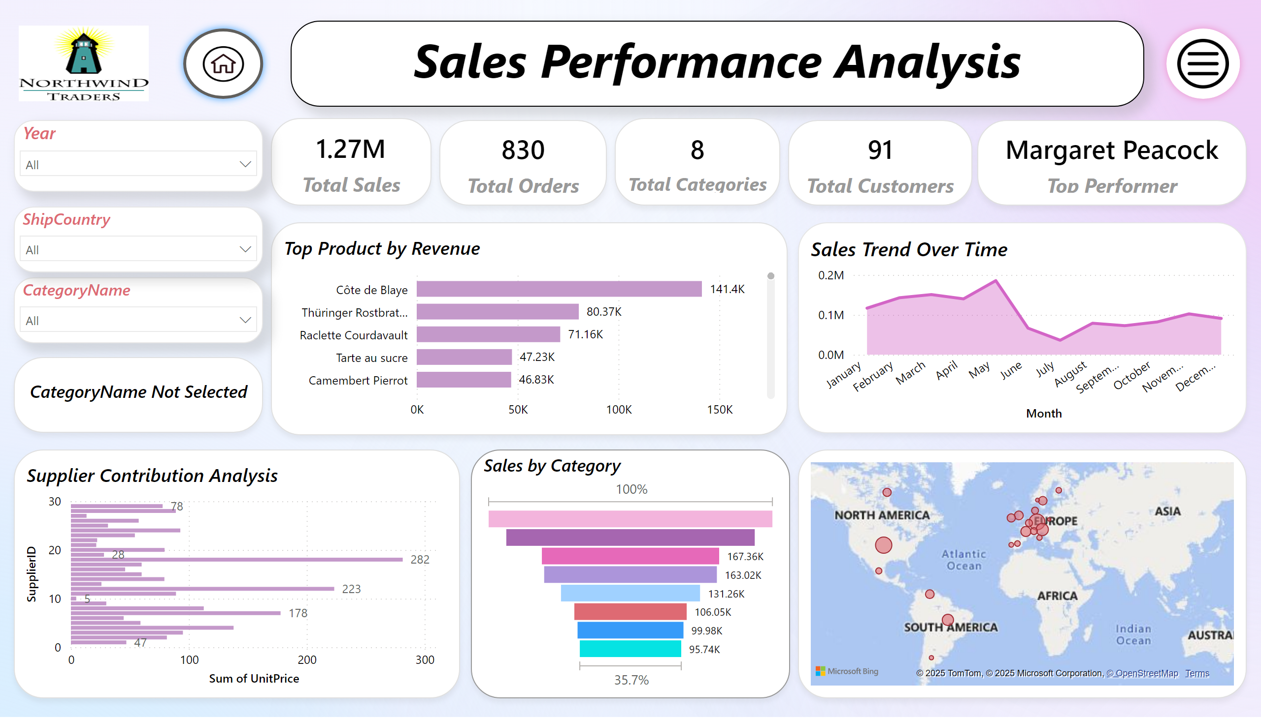
Dashboard
Notes:
textbox
No alt text provided
Sales Trend Over Time
No alt text provided
Sales by Category
No alt text provided
Top Product by Revenue
No alt text provided
Supplier Contribution Analysis
No alt text provided
map
No alt text provided
card
No alt text provided
card
No alt text provided
card
No alt text provided
card
No alt text provided
slicer
No alt text provided
slicer
No alt text provided
slicer
No alt text provided
card
No alt text provided
actionButton
No alt text provided
actionButton
No alt text provided
image
No alt text provided
card
No alt text provided

Slide 5
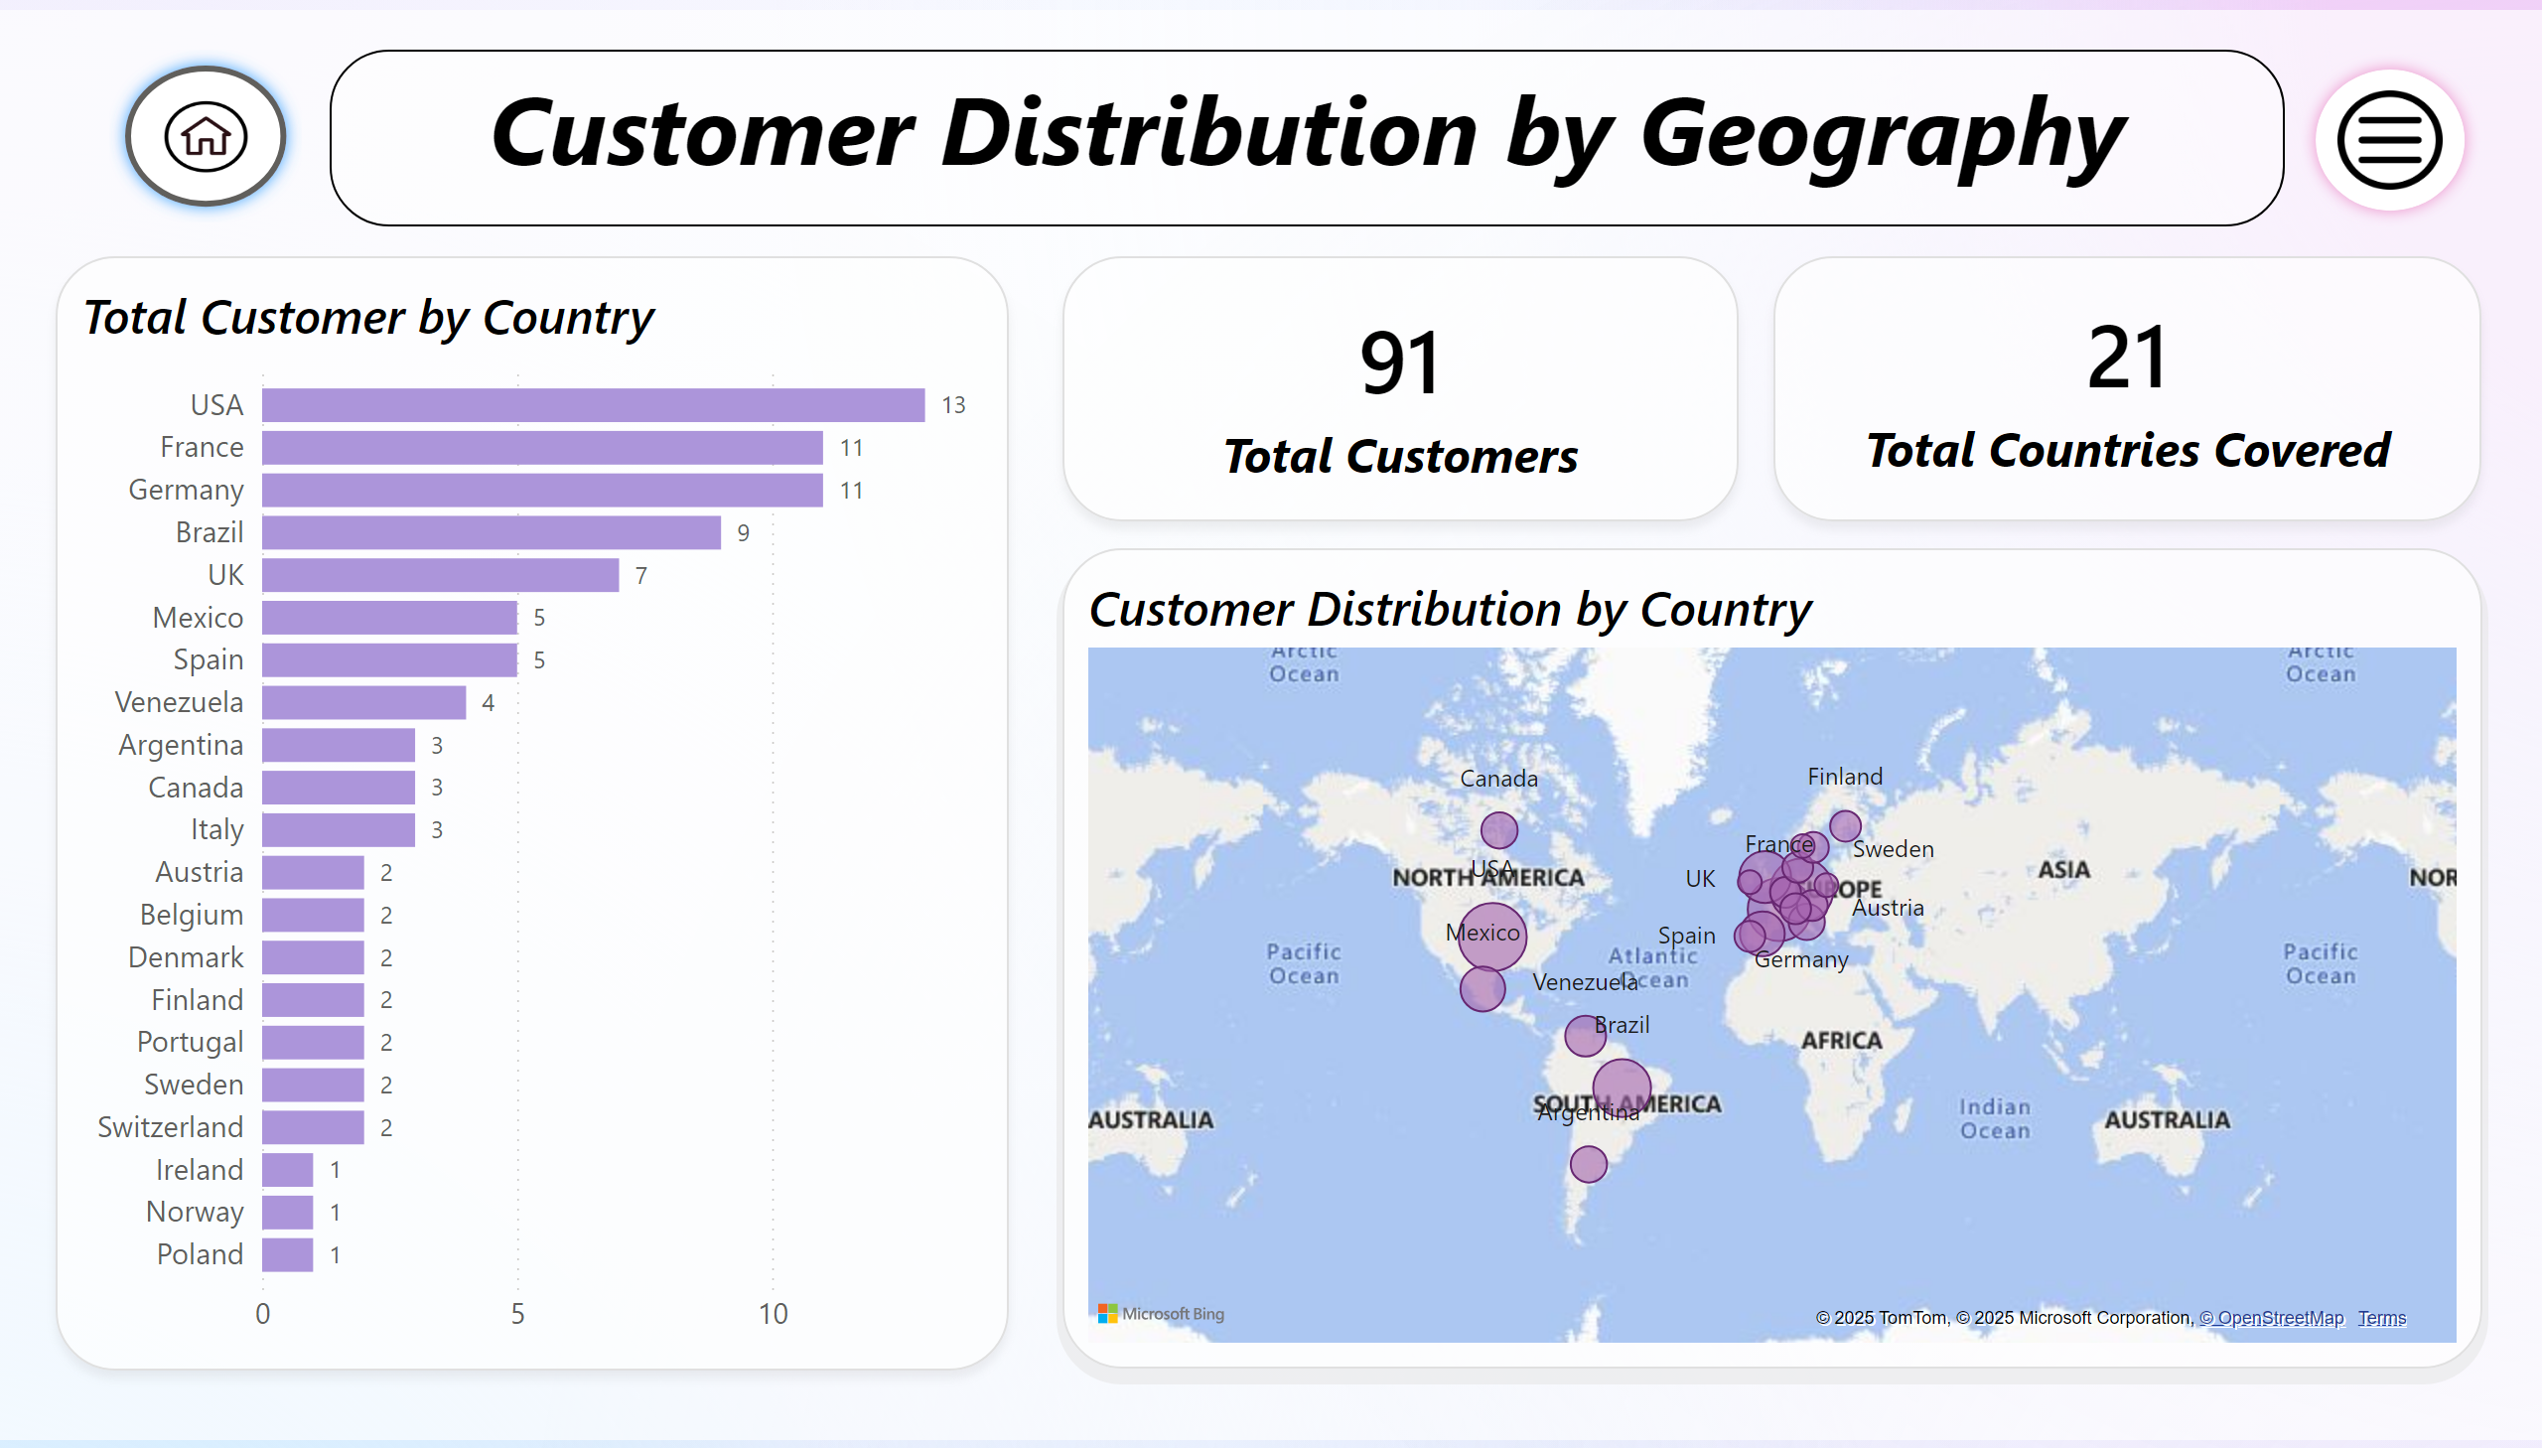
Q1
Notes:
textbox
No alt text provided
Total Customer by Country
No alt text provided
Customer Distribution by Country
No alt text provided
card
No alt text provided
card
No alt text provided
actionButton
No alt text provided
actionButton
No alt text provided

Slide 6
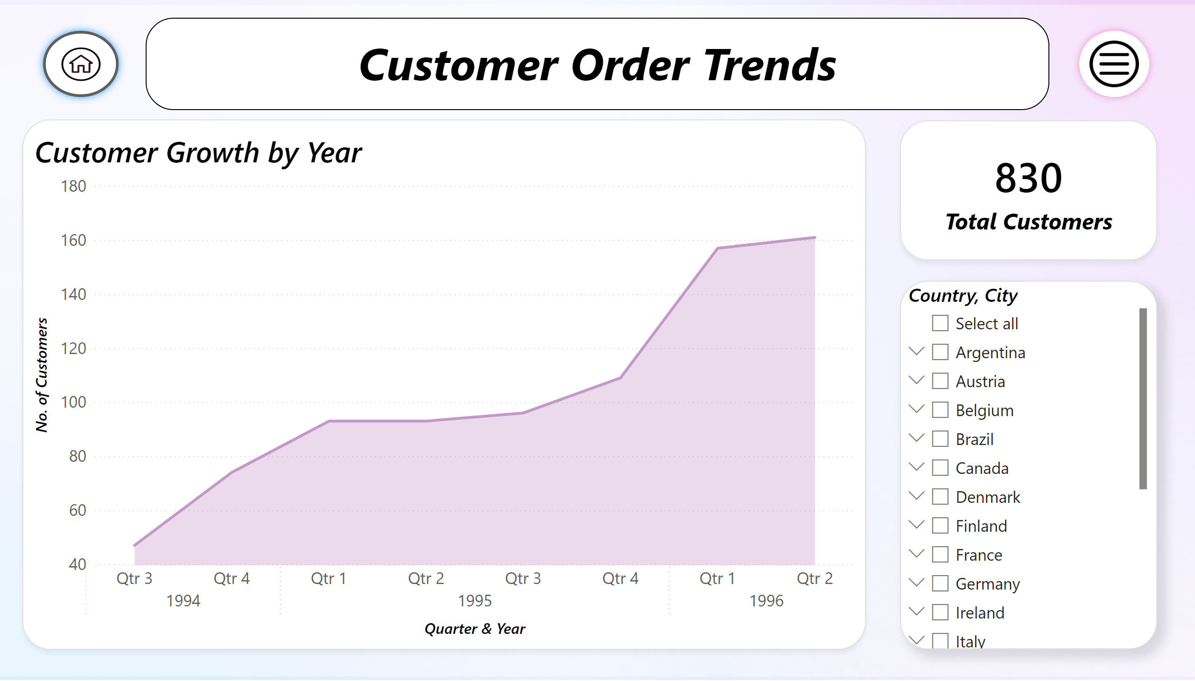
Q2
Notes:
textbox
No alt text provided
Customer Growth by Year
No alt text provided
slicer
No alt text provided
card
No alt text provided
actionButton
No alt text provided
actionButton
No alt text provided

Slide 7
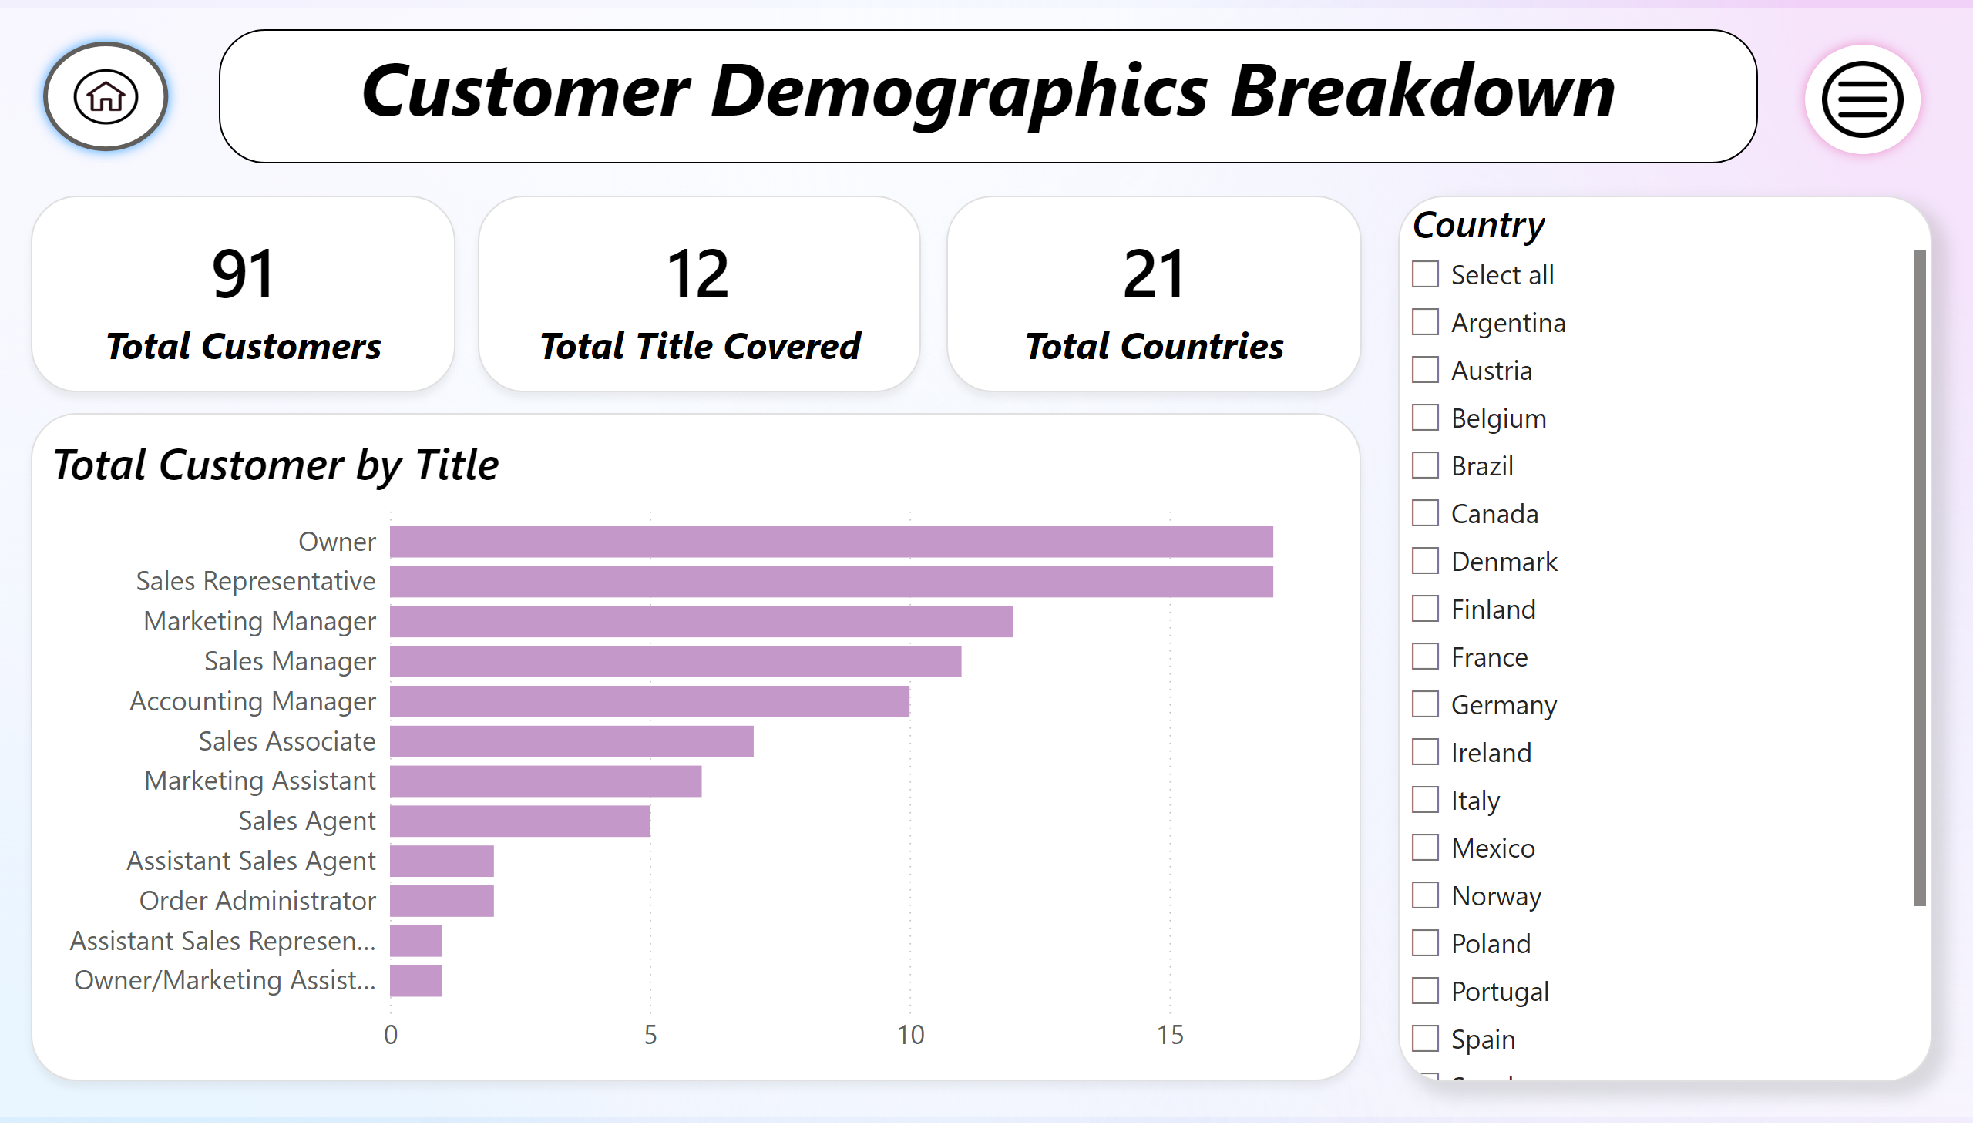
Q3
Notes:
textbox
No alt text provided
Total Customer by Title
No alt text provided
card
No alt text provided
card
No alt text provided
slicer
No alt text provided
card
No alt text provided
actionButton
No alt text provided
actionButton
No alt text provided

Slide 8
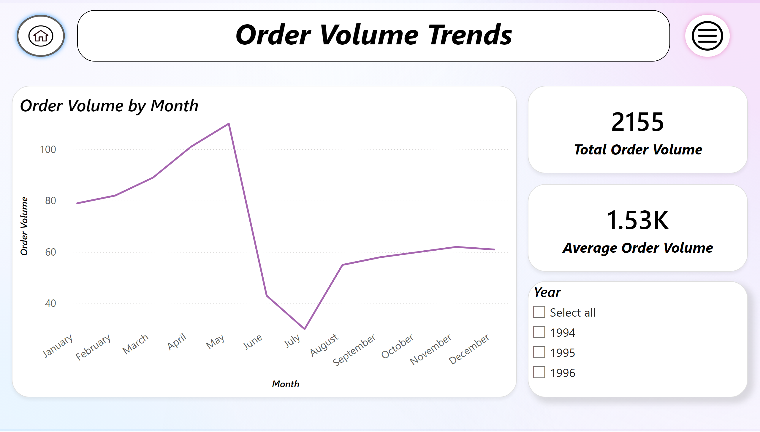
Q4
Notes:
textbox
No alt text provided
Order Volume by Month
No alt text provided
card
No alt text provided
card
No alt text provided
slicer
No alt text provided
actionButton
No alt text provided
actionButton
No alt text provided

Slide 9
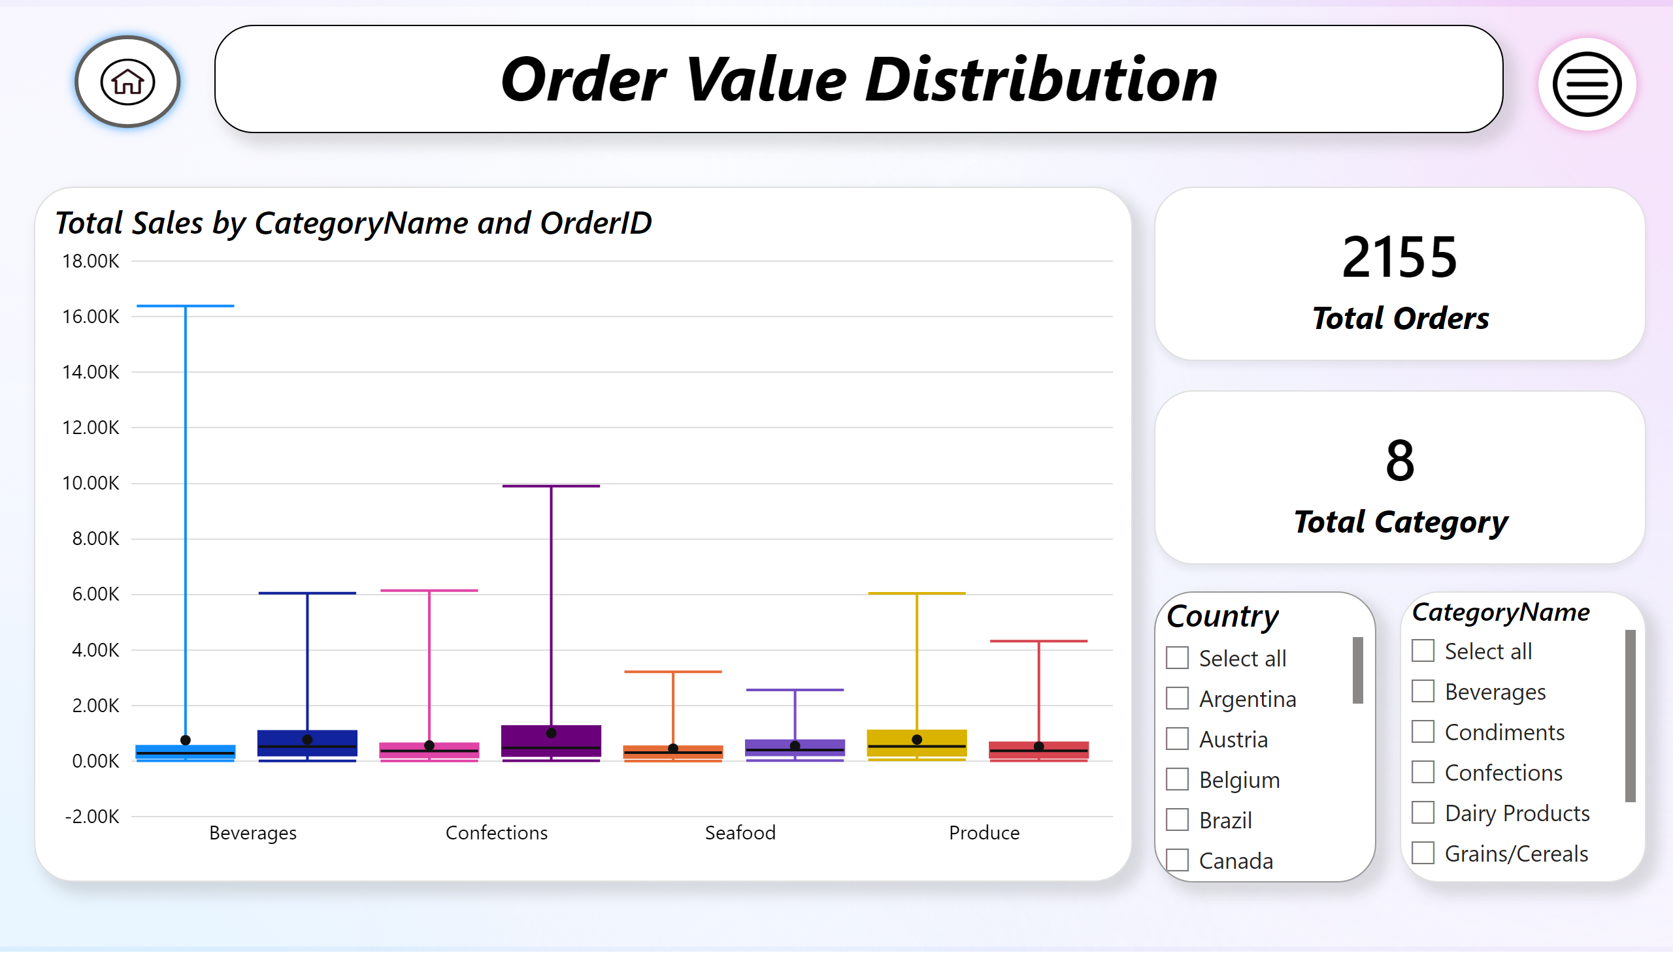
Q5
Notes:
textbox
No alt text provided
BoxWhiskerChart1455240051538
No alt text provided
slicer
No alt text provided
card
No alt text provided
card
No alt text provided
slicer
No alt text provided
actionButton
No alt text provided
actionButton
No alt text provided

Slide 10
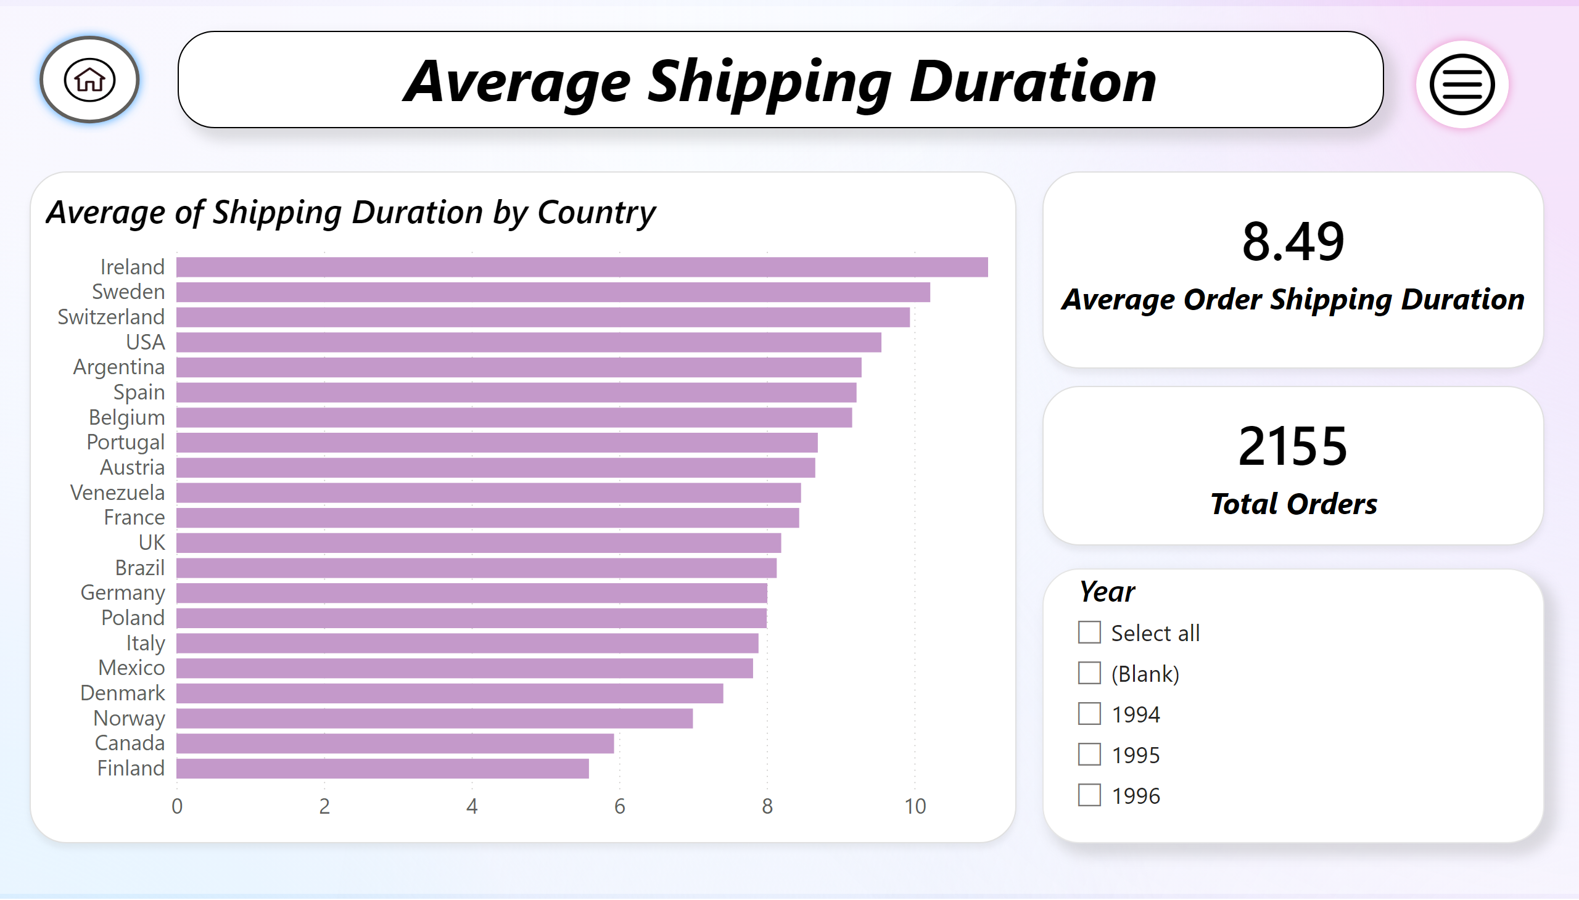
Q6
Notes:
textbox
No alt text provided
Average of Shipping Duration by Country
No alt text provided
card
No alt text provided
card
No alt text provided
slicer
No alt text provided
actionButton
No alt text provided
actionButton
No alt text provided

Slide 11
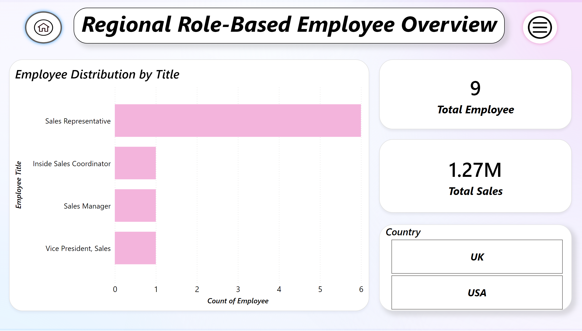
Q7
Notes:
textbox
No alt text provided
Employee Distribution by Title
No alt text provided
card
No alt text provided
slicer
No alt text provided
card
No alt text provided
actionButton
No alt text provided
actionButton
No alt text provided

Slide 12
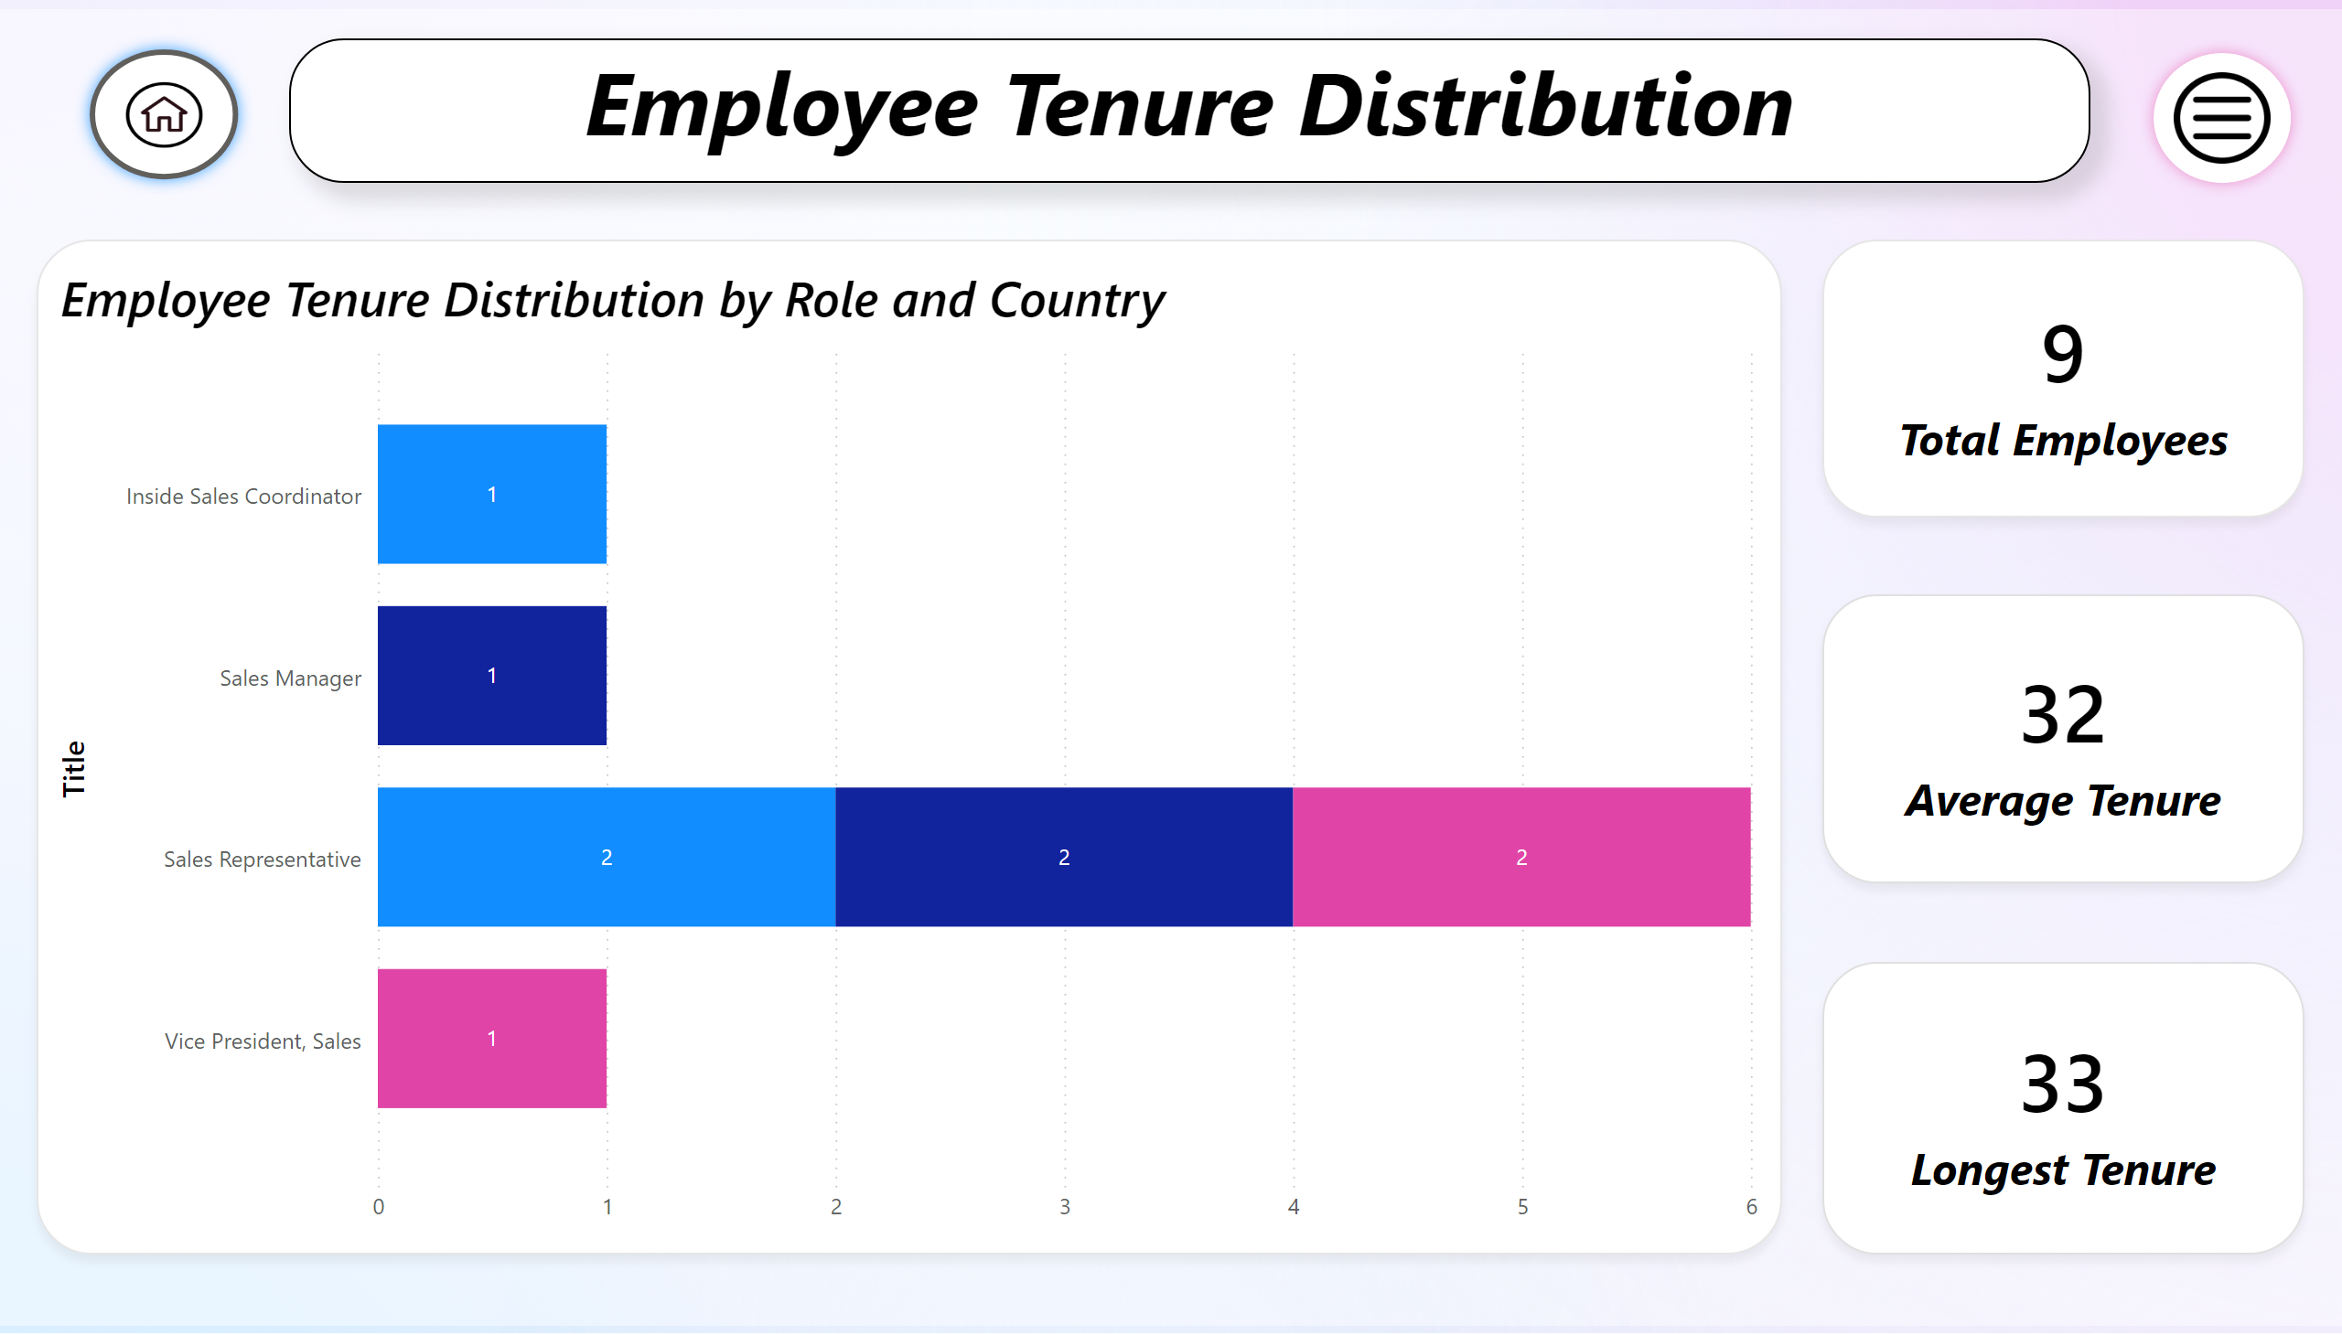
Q8
Notes:
textbox
No alt text provided
Employee Tenure Distribution by Role and Country
No alt text provided
card
No alt text provided
card
No alt text provided
card
No alt text provided
actionButton
No alt text provided
actionButton
No alt text provided

Slide 13
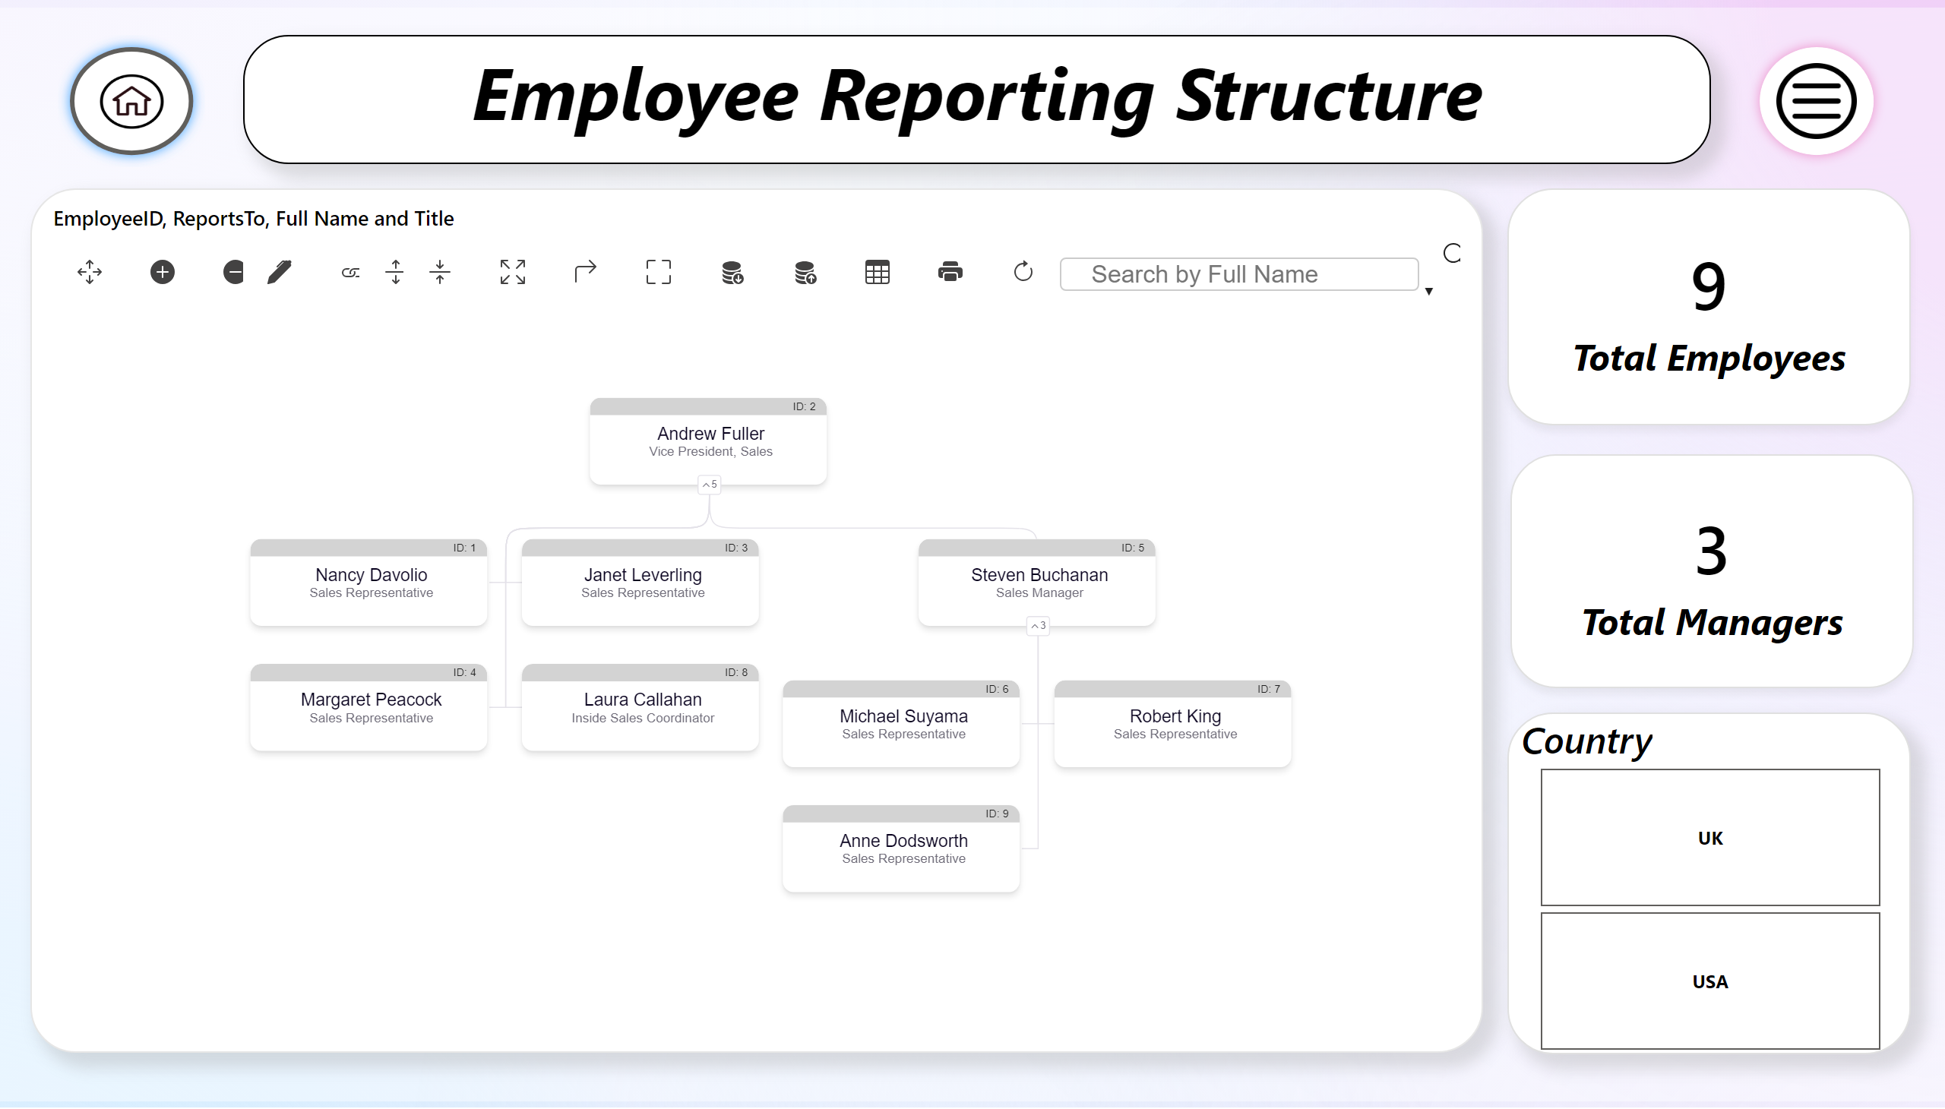
Q9
Notes:
textbox
No alt text provided
orgChart021B261450284A21B688B59A7342AC52
No alt text provided
card
No alt text provided
card
No alt text provided
slicer
No alt text provided
actionButton
No alt text provided
actionButton
No alt text provided

Slide 14
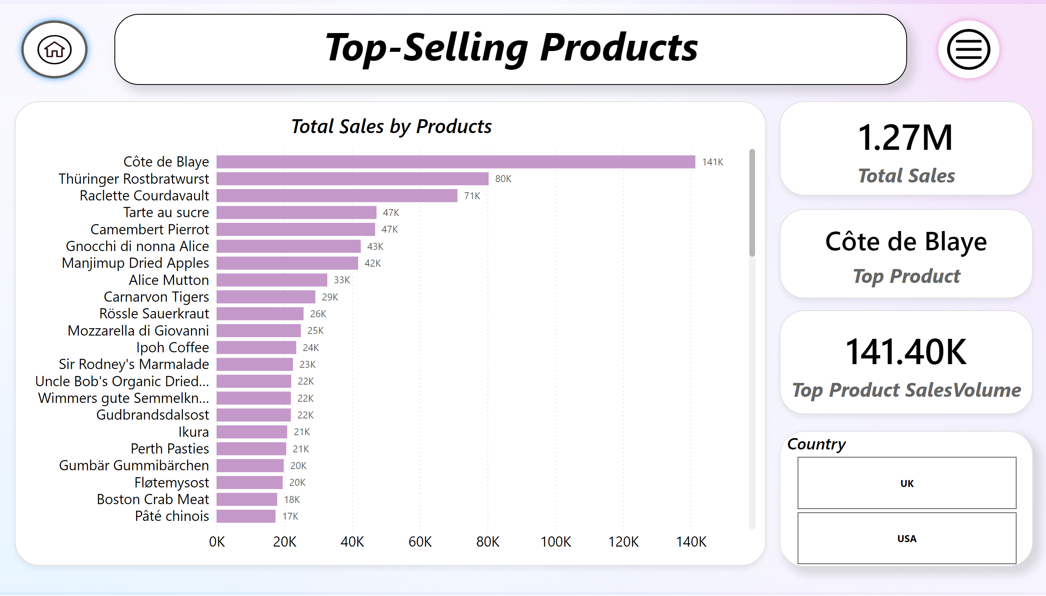
Q10
Notes:
textbox
No alt text provided
Total Sales by Products
No alt text provided
card
No alt text provided
card
No alt text provided
card
No alt text provided
slicer
No alt text provided
actionButton
No alt text provided
actionButton
No alt text provided

Slide 15
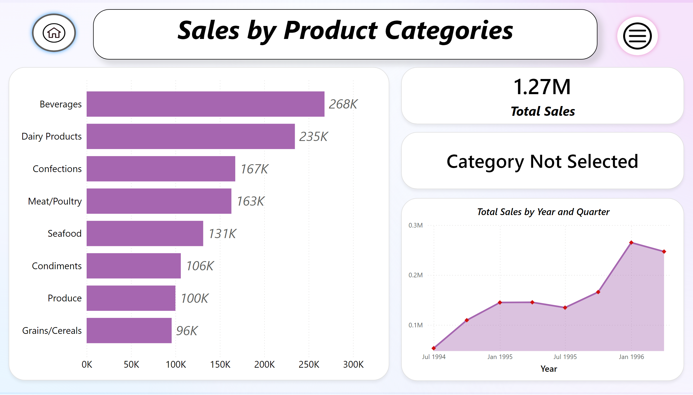
Q11
Notes:
textbox
No alt text provided
Sales by Product Category
No alt text provided
card
No alt text provided
card
No alt text provided
Total Sales by Year and Quarter
No alt text provided
actionButton
No alt text provided
actionButton
No alt text provided

Slide 16
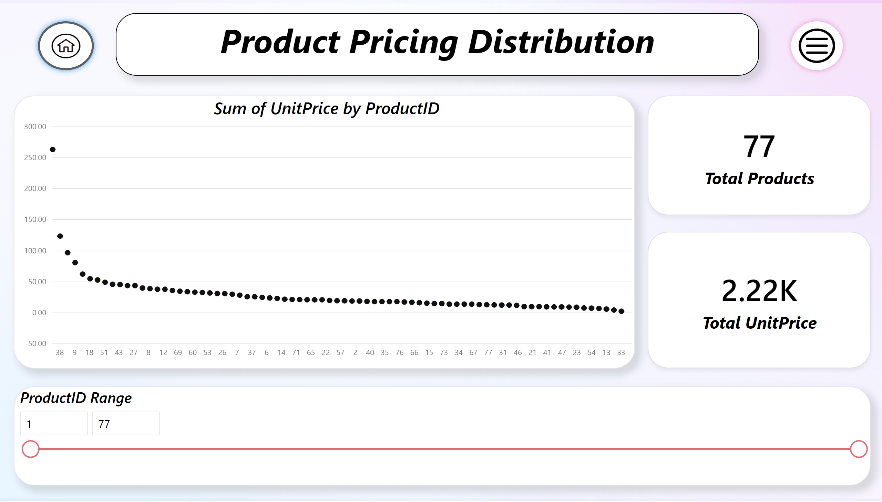
Q12
Notes:
textbox
No alt text provided
BoxWhiskerChart1455240051538
No alt text provided
card
No alt text provided
card
No alt text provided
slicer
No alt text provided
actionButton
No alt text provided
actionButton
No alt text provided

Slide 17
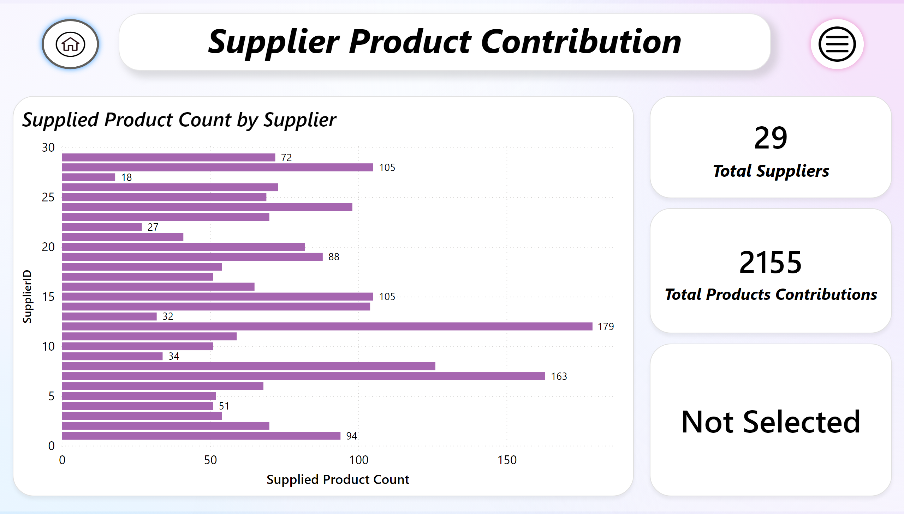
Q13
Notes:
textbox
No alt text provided
Supplied Product Count by Supplier
No alt text provided
card
No alt text provided
card
No alt text provided
card
No alt text provided
actionButton
No alt text provided
actionButton
No alt text provided

Slide 18
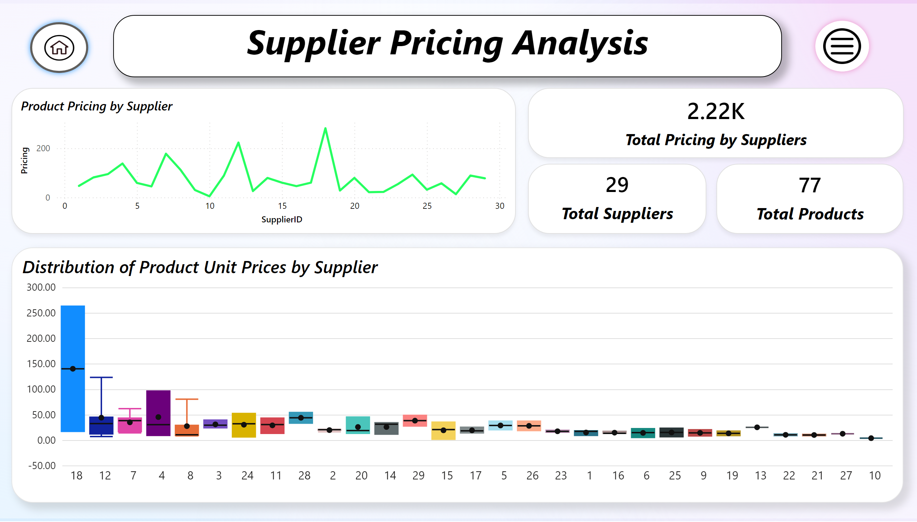
Q14
Notes:
textbox
No alt text provided
Distribution of Product Unit Prices by Supplier
No alt text provided
Product Pricing by Supplier
No alt text provided
card
No alt text provided
card
No alt text provided
card
No alt text provided
actionButton
No alt text provided
actionButton
No alt text provided

Slide 19
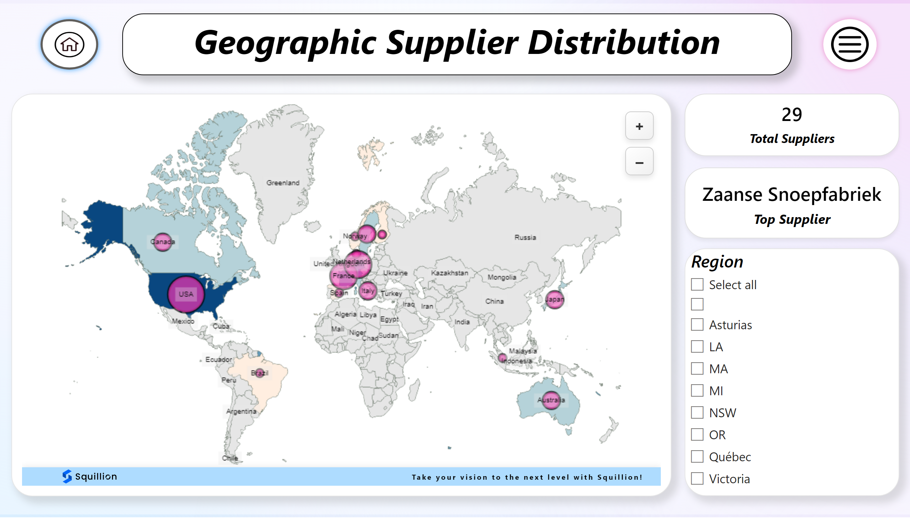
Q15
Notes:
textbox
No alt text provided
MapBySquillion
No alt text provided
card
No alt text provided
slicer
No alt text provided
card
No alt text provided
actionButton
No alt text provided
actionButton
No alt text provided

